Slide 1
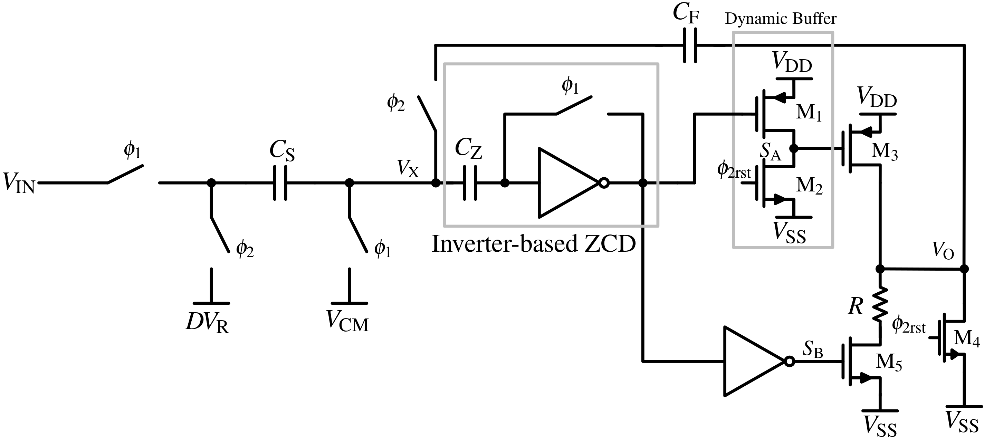
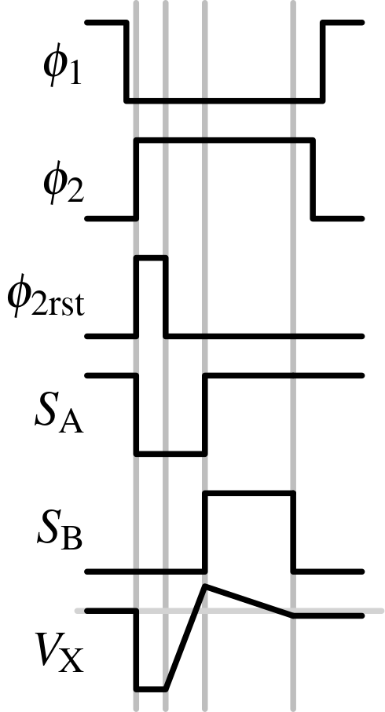
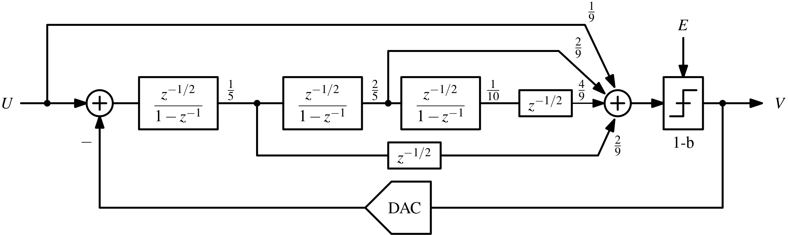
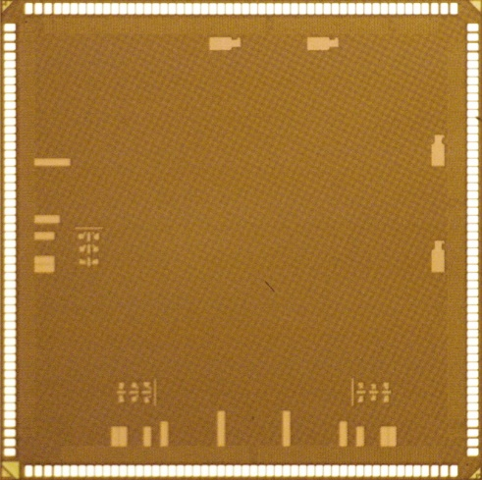
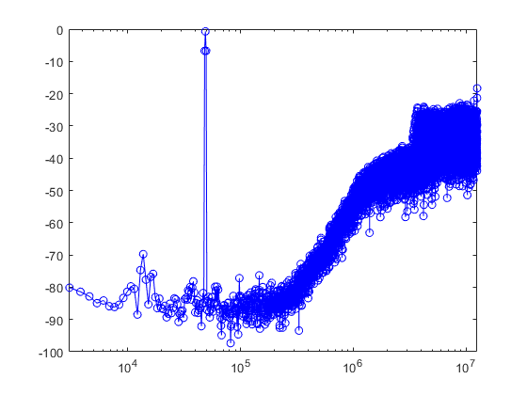
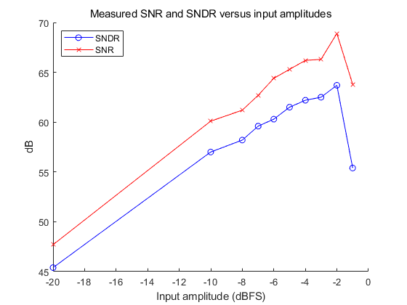

A Zero-Crossing-Based Integrator with Bi-directional Two-Phase Charging
Dong-Jick Min* and Jae Hoon Shim
School of Electronic and Electrical Engineering, Kyungpook National University
Introduction
The zero-crossing-detector (ZCD) and current source can replace OTA.
The zero-crossing-based integrators (ZCBIs) make signal-dependent error due to the delay of ZCD.
Signal-dependent errors can be suppressed by applying proposed two-phase charging scheme.
Circuit Design
Architecture
Proposed ZCBI circuit.
Error is determined by threshold voltage of M5 ($V_{th|M5})$ and gain of inverter ($A$).
$V_{ERROR}=V_{X}−V_{CM}=\frac{|V_{th|M5}−V_{trip}|}{A^{2}}$.
Third-order Delta-Sigma modulator.
:Low-distortion feedforward structure.
Half-delay and pseudo-differential zero-crossing-based integrators.
1-bit quantizer & passive adder.
Implementation
Performance Summary
Process
: 28-nm Samsung
: Core Area : 0.3 mm x 0.15 mm
(0.045mm²)
Measurement Result
Power Spectral Density (PSD) Input Amplitude vs. SNDR
 | Post-Sim. | Meas.
Technology (nm) | 28 | 28
Supply voltage (V) | 1 | 1
Signal Bandwidth (kHz) | 196 | 196
Clock Frequency (MHz) | 25 | 25
Oversampling Ratio (OSR) | 64 | 64
Power Consumption (uW) | 188 | 216
Peak SNR (dB) | 75.6 | 69.8
Peak SNDR (dB) | 72.2 | 63.1
Dynamic Rage (dB) |  | 65
Conclusion
The integrator uses a new two-phase charging scheme, which is better than conventional two-phase charging schemes in terms of signal-dependent errors, resulting in suppressed harmonic distortions.
The measurements show poor linearity because of some mistakes in the chip design.
Acknowledge
The chip fabrication and EDA tools were supported by the IC Design Education Center (IDEC), Korea.

